Slide 1
Email Marketing
Landon Gwynn P.3

Slide 2
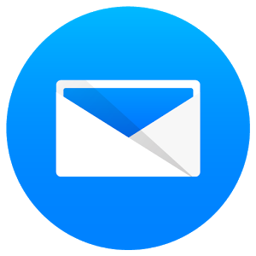
What?
promote brands, products, offers, etc.

Slide 3
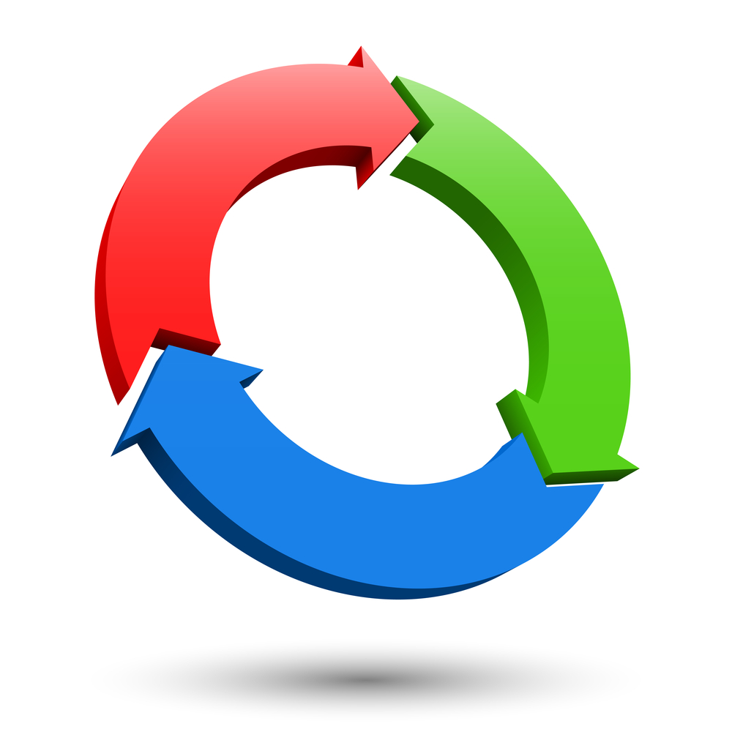
Why?
Conversion rates higher than search and social

Slide 4
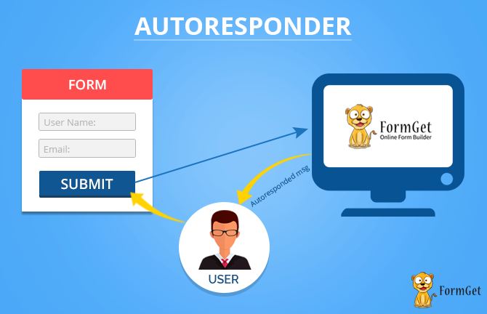
Autoresponder
Scheduling/Automation Workflows
GetResponse
Aweber
ActiveCampaign

Slide 5
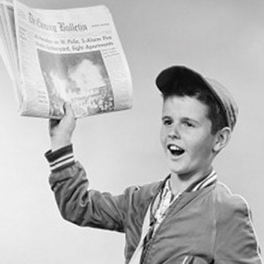
Email Marketing Strategies
Newsletter
Autoresponder Sequence
Combination

Slide 6
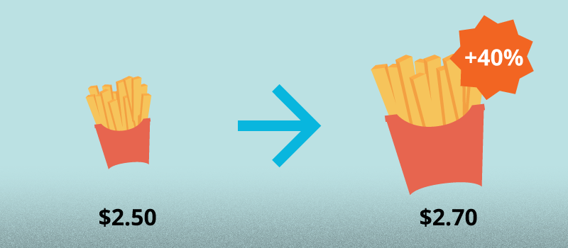
More Strategies
Upselling/Cross-Selling
Affiliate Marketing
ClickBank, JVZoo, etc.

Slide 7
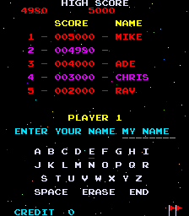
Advanced Methods
Automation
Scoring
Tagging
Tracking Pixels

Slide 8
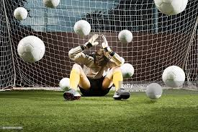
Frequency
“Churn and Burn”
1-2 times a week
Middle ground

Slide 9

Optimization
Subject Line
Timing
Personalization
Body Styles
CTR

Slide 10
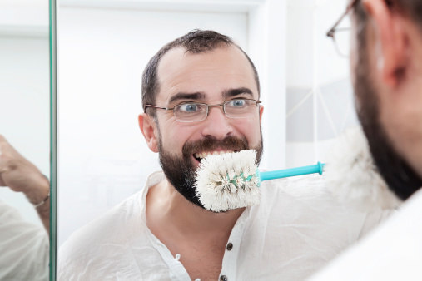
Maintenance
Lead Quality
Segmentation
Hygiene

Slide 11
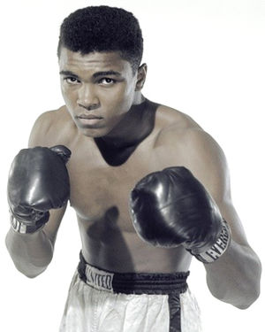
So What?
Compare autoresponders
Marketing plan
Test Styles
Hygiene

